Slide 1
ReactJS and Drupal 8
Writing content rich JavaScript/REST web apps.
Drupal GovCon, Washington DC
Jitesh Doshi, SpinSpire
@spinspire_com Source code: https://bitbucket.org/spinspire/d8-react-v2

Slide 2
Motivation
Drupal is your favorite CMS
AJAX apps and SPA's are cool!
ReactJS is the HOTTEST thing (Or is it vue.js now?)
REST support: D7 contrib, D8 core
D8's Content + React's UX == Awesome!

Slide 3
Architecture
SITE1 Static Web Server Serving JS App (http://localhost:300/)
Browser Running JS App And making AJAX request to REST services
JavaScript code
cross-origin
SITE2 PHP App Server Serving Drupal Content As ReST Service (http://spinspire.com/)
JSON/ReST

Slide 4
Setup
Get the source code from https://bitbucket.org/spinspire/d8-react-v2/
Study the custom module in 'drupal/headless'
Study the ReactJS app in 'src'
Follow the full instructions in README.md.

Slide 5
RESTful services in Drupal 8
GET http://localhost/node/1?_format=json
POST http://localhost/entity/node
PATCH http://localhost/node/1
DELETE http://localhost/node/1
Create views and add "REST export" display.
GET http://localhost/node/rest
And much more!!!

Slide 6

SpinSpire is a Drupal focused company.
All developers located in Jacksonville, Florida.
Contributed modules: popular_tags & prlp.
Clients such as Nike, Florida Blue and Federal Govt.
Find us on the web, or visit https://spinspire.com/

Slide 7
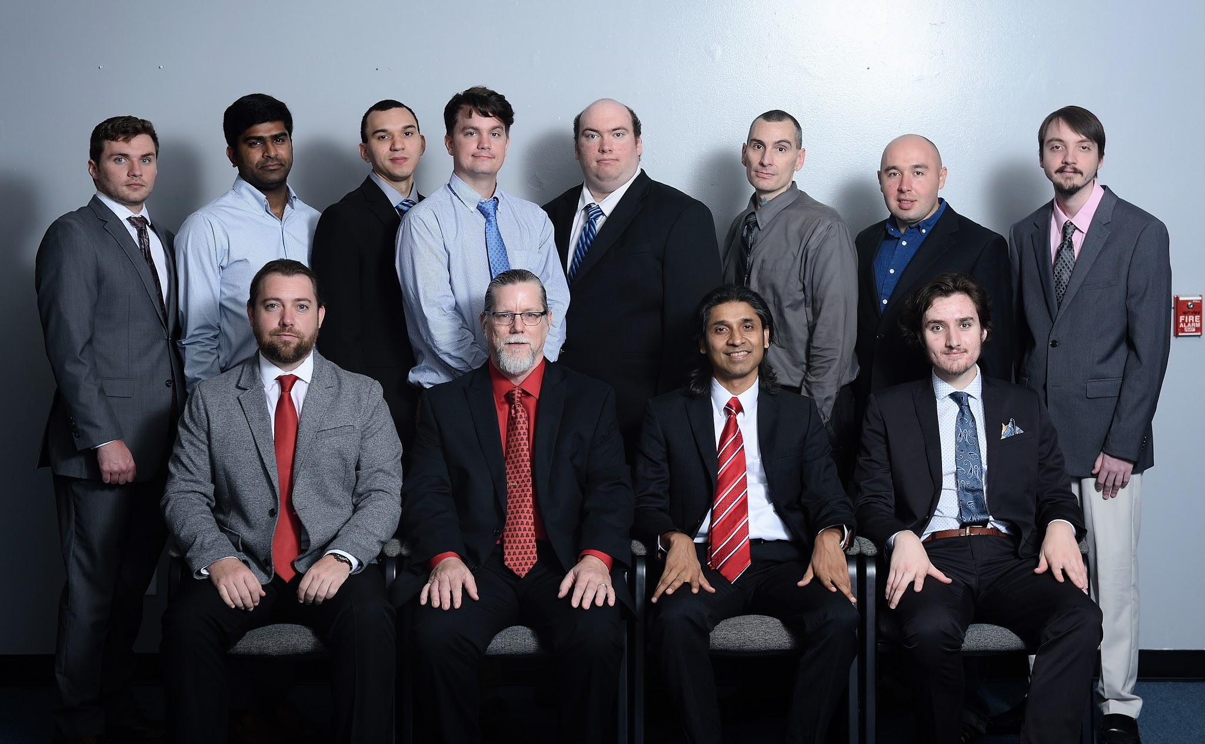

Slide 8
Drupal 8 - CSRF and Authentication
JavaScript code should get CRSF token from /rest/session/token
Include token as X-CSRF-Token in all requests
JS app deployed to a subdomain of D8
So that authentication cookie can be shared
Configure Drupal REST to use cookie auth

Slide 9
Drupal 8 - CORS
Configure cors.config in services.yml.
cors.config:
enabled: true
allowedHeaders: ['x-csrf-token', 'content-type']
allowedMethods: ['GET','POST','PATCH', 'DELETE']
allowedOrigins: ['*']
supportsCredentials: true

Slide 10
Recipe: ReactJS App in Drupal 8
Use this demo app as the starting point. Run it from http://localhost:3000/
Run a Drupal site anywhere with the provided config.
Develop and test React app in standalone mode, using "npm run dev".
Compile to dist with "npm run build"

Slide 11
ReactJS App Development
Install npm.
Follow a productive dev workflow using webpack-dev-server.
Implement basic ReactJS components.
Implement basic state management - App is the only stateful component. All others are pure functional.
Use axios for AJAX requests. Configure it to include X-CSRF-Header and credentials cookie.

Slide 12
For More Information
Screencast Video: Coming soon!
Source code: https://bitbucket.org/spinspire/d8-react-v2
Email: jitesh@spinspire.com
Follow @spinspire_com
Visit spinspire.com
Other video screencasts youtube.com/spinspire

